Slide 1
Linear Models
CS771: Introduction to Machine Learning
Piyush Rai

Slide 2
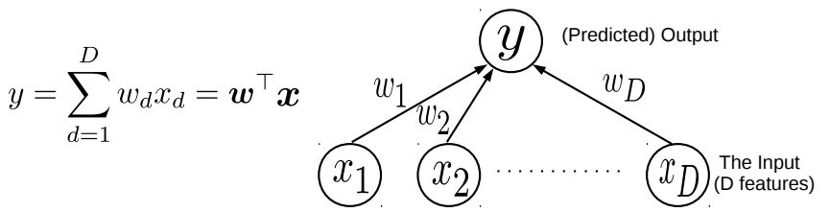


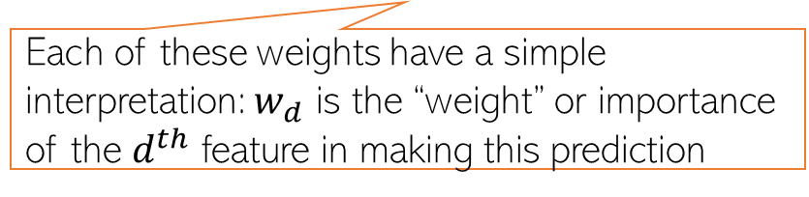
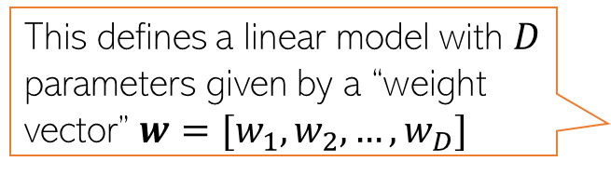
Linear Models
2
Consider learning to map an input $x∈ℝ^{D}$ to the corresponding (say real-valued) output $y$
Assume the output to be a linear weighted combination of the $D$ input features
This simple model can be used for Linear Regression
This simple model can also be used as a “building block” for more complex models
Even classification (binary/multiclass/multi-output/multi-label) and various other ML/deep learning models
Even unsupervised learning problems (e.g., dimensionality reduction models)
This defines a linear model with $D$ parameters given by a “weight vector” $w=[w_{1},w_{2},…,w_{D}]$
Each of these weights have a simple interpretation: $w_{d}$ is the “weight” or importance of the $d^{th}$ feature in making this prediction
The “optimal” weights are unknown and have to be learned by solving an optimization problem, using some training data

Slide 3
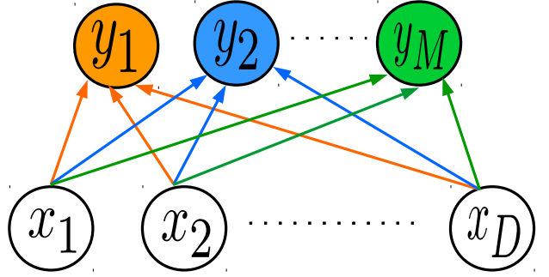

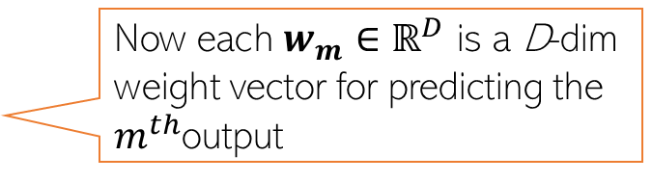



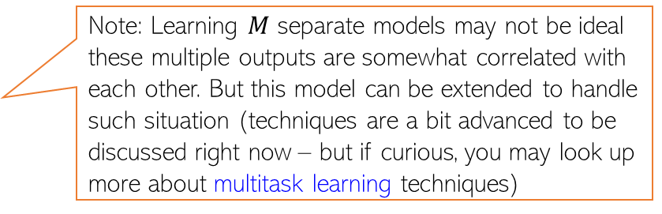



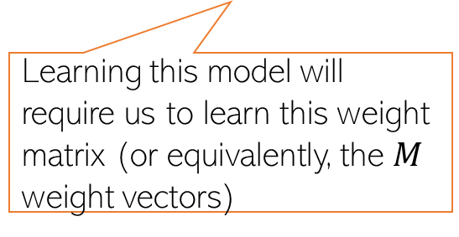


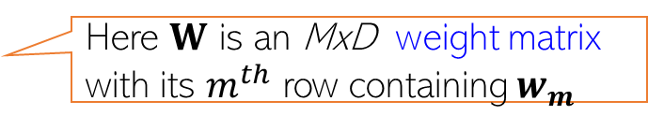
Simple Linear Models as Building Blocks
3
In some regression problems, each output itself is a real-valued vector $y∈ℝ^{M}$
Example: Given a full body image of a person, predict height, weight, hand size, and leg size ($M=4)$
Such problems are commonly known as multi-output regression
We can assume a separate linear model for each of the $M$ outputs $y_{m }(m=1,2,…,M)$
Now each $w_{m}$ $∈ℝ^{D}$ is a D-dim weight vector for predicting the $m^{th}$output
$$y_{m}= w_{m}^{⊤}x$$
$$y=Wx$$
Here $W$ is an MxD weight matrix with its $m^{th}$ row containing $w_{m}$
$$w_{1}^{⊤}$$
Note: Learning $M$ separate models may not be ideal these multiple outputs are somewhat correlated with each other. But this model can be extended to handle such situation (techniques are a bit advanced to be discussed right now – but if curious, you may look up more about multitask learning techniques)
Learning this model will require us to learn this weight matrix (or equivalently, the $M$ weight vectors)
$$w_{2}^{⊤}$$
$$w_{M}^{⊤}$$
$$x$$
$$y$$
$$W$$

Slide 4
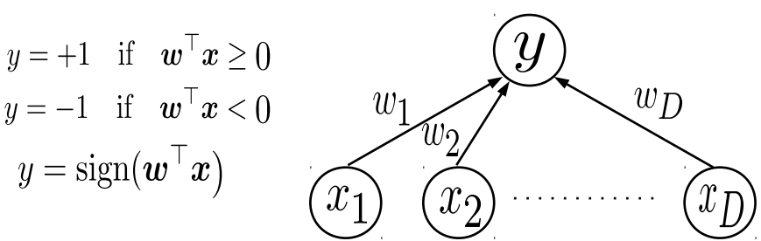

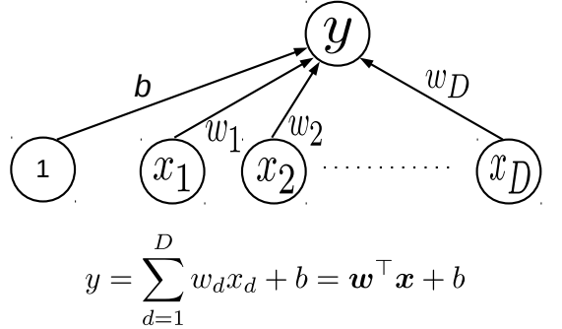
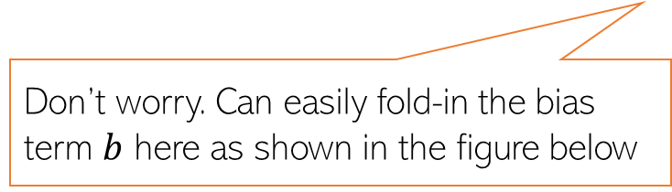

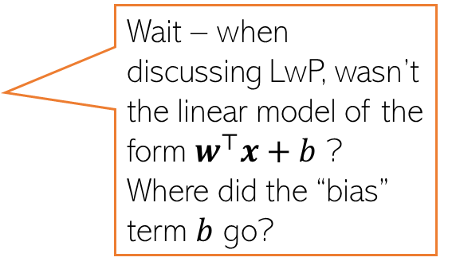
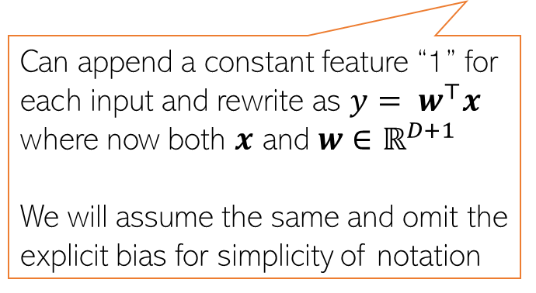
Simple Linear Models as Building Blocks
4
A linear model $y= w^{⊤}x$ can also be used in classification problems
For binary classfn, can treat $w^{⊤}x$ as the “score” of input $x$ and threshold to get binary label
Recall that the LwP model can also be seen as a linear model (although it wasn’t formulated like this)
Don’t worry. Can easily fold-in the bias term $b$ here as shown in the figure below
Wait – when discussing LwP, wasn’t the linear model of the form $w^{⊤}x+b$ ? Where did the “bias” term $b$ go?
Can append a constant feature “1” for each input and rewrite as $y= w^{⊤}x$ where now both $x$ and $w∈$ $ℝ^{D+1}$
We will assume the same and omit the explicit bias for simplicity of notation

Slide 5

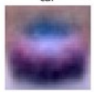
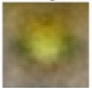
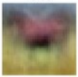

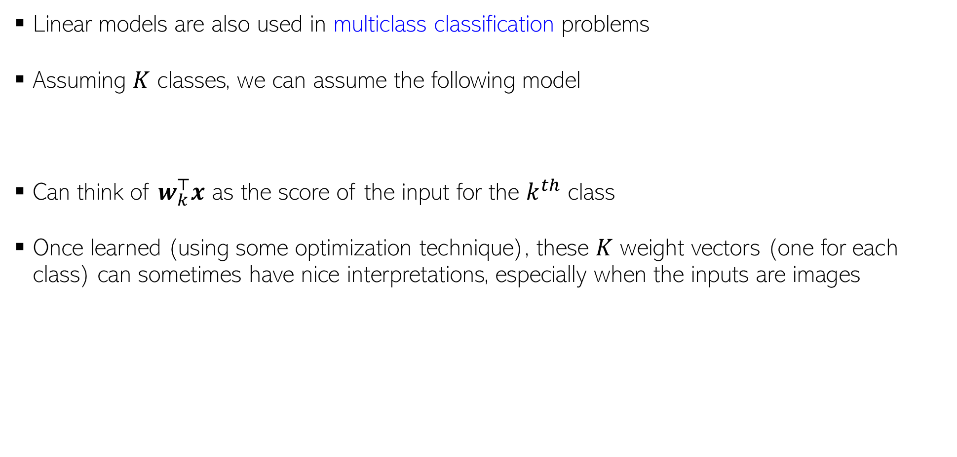





Simple Linear Models as Building Blocks
5
Linear models are also used in multiclass classification problems
Assuming $K$ classes, we can assume the following model
Can think of $w_{k}^{⊤}x$ as the score of the input for the $k^{th}$ class
Once learned (using some optimization technique), these $K$ weight vectors (one for each class) can sometimes have nice interpretations, especially when the inputs are images
$$y= {argmax}_{k∈\{1,2,…,K\}} w_{k}^{⊤}x$$
The learned weight vectors of each of the 4 classes visualized as images – they kind of look like a “template” of what the images from that class should look like
These images sort of look like class prototypes if I were using LwP ☺
$$w_{car}$$
$$w_{frog}$$
$$w_{horse}$$
$$w_{cat}$$
Yeah, “sort of”. ☺
No wonder why LwP (with Euclidean distances) acts like a linear model. ☺
That’s why the dot product of each of these weight vectors with an image from the correct class will be expected to be the largest

Slide 6
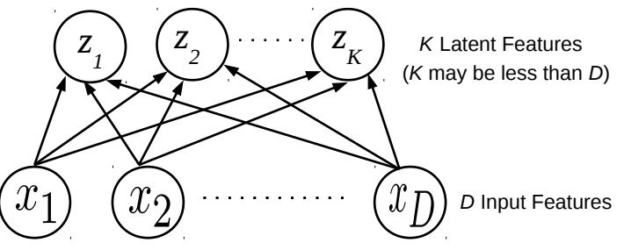
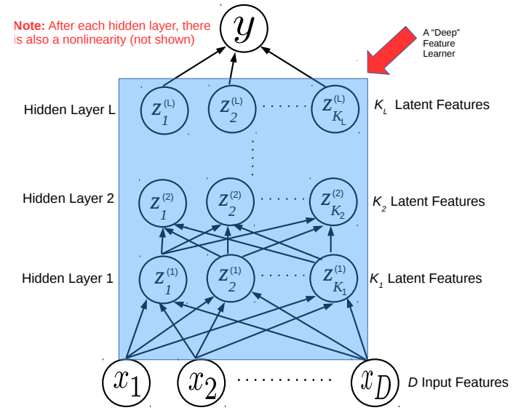
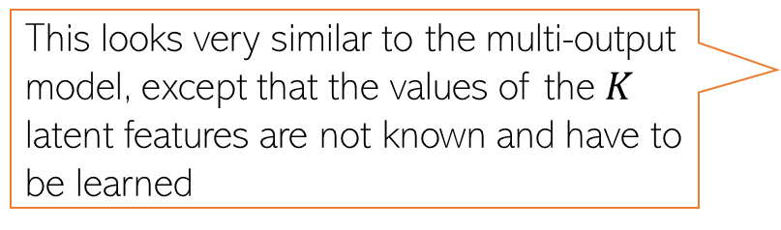
Simple Linear Models as Building Blocks
6
Linear models are building blocks for dimensionality reduction methods like PCA
Linear models are building blocks for even deep learning model (each layer is like a multi-output linear model, followed by a nonlinearity)
This looks very similar to the multi-output model, except that the values of the $K$ latent features are not known and have to be learned
In a deep learning model, each layer learns a latent feature representation of the inputs using a model like a multi-output linear model, followed by a nonlinearity
The last (output) layer can have one or more outputs
More on this when we discuss deep learning later

Slide 7
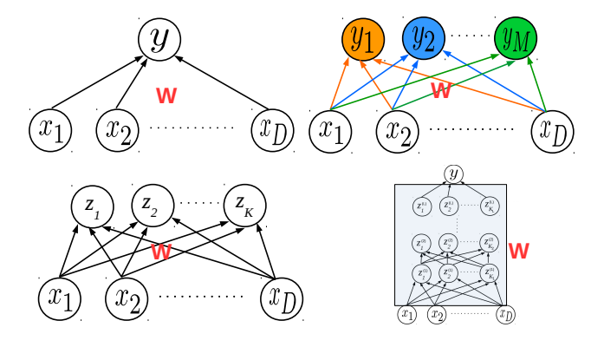
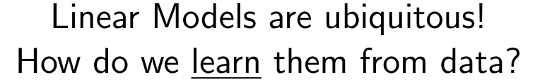
Learning Linear Models
7

Slide 8
Next Lecture
Linear Regression

